Slide 1



Notes:
1.7.2013
1.7.2013
1
‹#›
‹#›

Slide 2

PROJECT TITLE:
Fraud Detection System For Financial Transactions
Presented By:Group-5
Batch-62(C)
Course Code:CSE0612302
Submitted to:
Md. Ashraful Kabir
Senior Lecturer, Dept. Of CSE
Uttara University
Notes:
1.7.2013
1.7.2013
1
‹#›
‹#›

Slide 3
Topic Overview:
·Project Overview
·Problem Statement(Why This Project Matters?)
·Project Objectives
·System Modules
·How The System Works
·Technology Stack
·Development Methodology
·Project Timeline
·Risk Analysis
·Evaluation Criteria
Notes:
1.7.2013
1.7.2013
1
‹#›
‹#›

Slide 4



Team Members & Responsibilities
Tamim Sheikh
Rafiul Hasan
Hasan Ahmmad
2243081086
2243081084
2243081101
Team Lead, Backend,
System Architect
Frontend , UI,
Testing
Database Design,SQL,
Documentation
Notes:
1.7.2013
1.7.2013
2
‹#›
‹#›

Slide 5
Project Overview
Project Title
Fraud Detection System for Financial Transactions
Purpose
Develop a secure web-based system that detects suspicious financial transactions in real time using predefined rulebased techniques.
Key Features
Real-time Transaction Monitoring
Rule-based Fraud Detection
Instant Fraud Alerts
Admin Dashboard
Reports & Analytics
Target Users
System Administrators
Fraud Analysts
Expected Outcomes
A secure, reliable, and user-friendly platform that reduces financial fraud and improves customer trust.
Notes:
1.7.2013
1.7.2013
3
‹#›
‹#›

Slide 6


Why This Project Matters?
Millions of online transactions occur every day — and cyber fraud is accelerating. Manual monitoring simply cannot keep pace with the speed and scale of modern financial crime.
The Problem
Unauthorized access & identity theft
Slow, error-prone manual reviews
Billions dollars lost to fraud annually
Our Solution
A smart, rule-based fraud detection engine that identifies suspicious transactions instantly — calculating risk scores, triggering alerts, and empowering admins to act before damage is done.
Notes:
1.7.2013
1.7.2013
3
‹#›
‹#›

Slide 7






Project Objectives
Six core objectives guide the system's design and implementation.
Secure Database
Admin Authentication
Encrypted storage with role-based access control
Secure login and session management
Customer & Account Management
Transaction Monitoring
Full lifecycle management of customers and accounts
Real-time tracking of all financial activity
Fraud Detection
Reports & Dashboard
Rule-based engine with dynamic risk scoring
Visual insights and audit-ready reports
Notes:
1.7.2013
1.7.2013
5
‹#›
‹#›

Slide 8
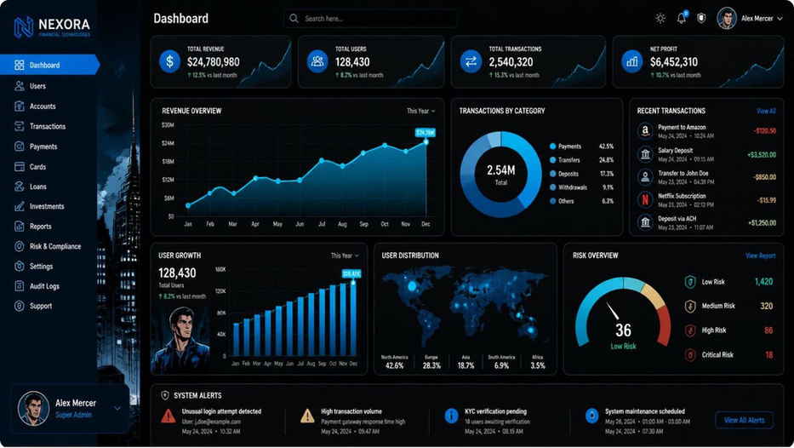

System Modules
The system is organized into six interconnected modules, each managed through a centralized admin dashboard.
Dashboard
Customers & Accounts
Transactions
Fraud Detection & Alerts
Central command center with real-time metrics
User profiles, account creation, and management
Full transaction log with search and filtering
Automated flagging and risk notifications
Reports
Exportable analytics and compliance summaries
Notes:
1.7.2013
1.7.2013
6
‹#›
‹#›

Slide 9

How the System Works
Every transaction flows through a structured pipeline designed to catch fraud before it causes harm. The system evaluates each transaction in real time, assigns a risk score, and escalates suspicious activity for human review.
Transaction Received
Risk Analysis
Fraud Alert
Admin Review
The pipeline operates in real time — from transaction receipt to alert generation in seconds. Admins receive flagged transactions with full context, enabling fast, informed decisions that minimize false positives and reduce financial exposure.
Notes:
1.7.2013
1.7.2013
4
‹#›
‹#›

Slide 10
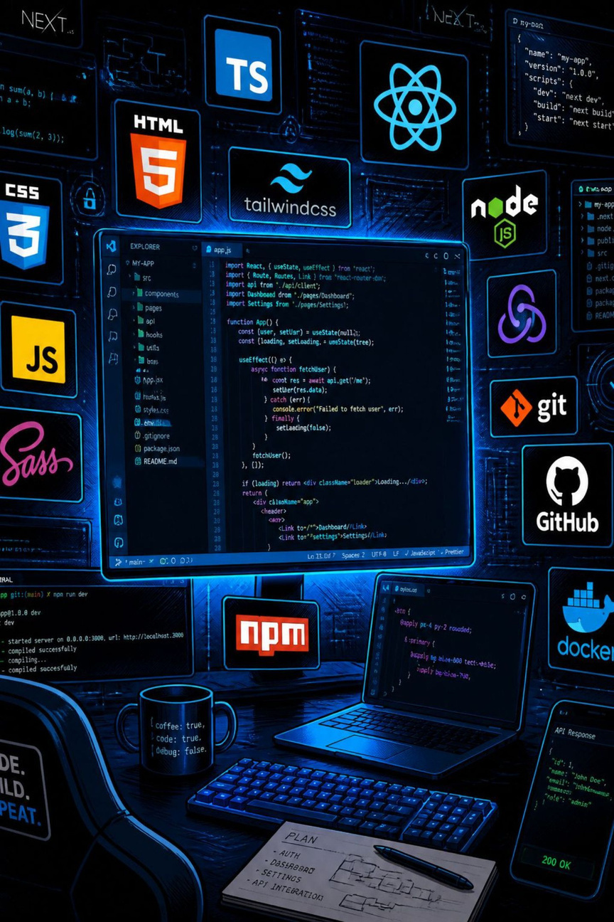




Technology Stack
A modern, industry-standard stack chosen for performance, scalability, and developer productivity.
Frontend
HTML & CSS
JavaScript
React.js
Backend
Node.js
Express.js
Database
MySQL
Tools
GitHub
Figma
Draw.io
Postman
Notes:
1.7.2013
1.7.2013
7
‹#›
‹#›

Slide 11
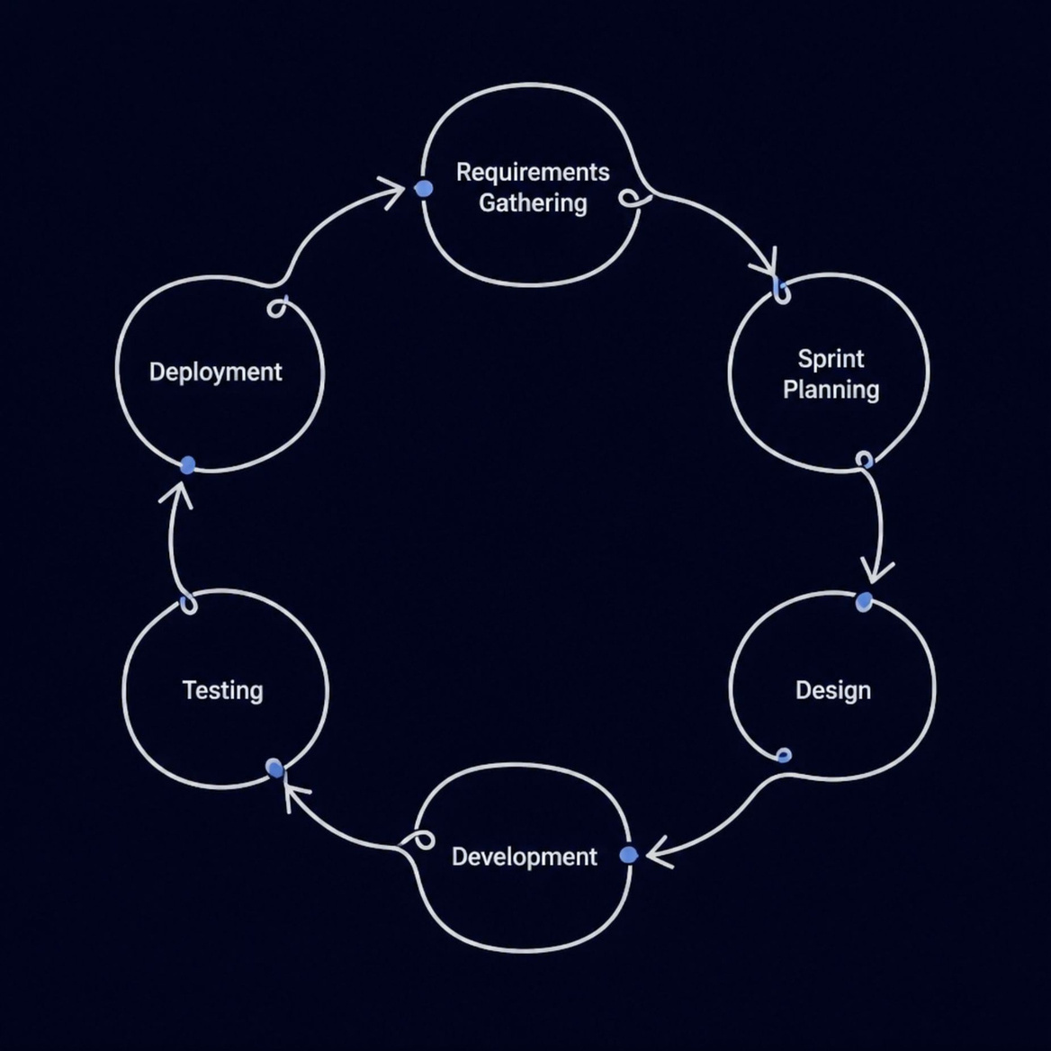
Development Methodology
Why Agile?
Agile methodology enables our team to deliver working increments rapidly, respond to feedback, and adapt to changing requirements throughout the project lifecycle.
Short sprints with clear deliverables
Continuous testing integrated at each stage
Regular team reviews and retrospectives
Notes:
1.7.2013
1.7.2013
8
‹#›
‹#›

Slide 12



Project Timeline
A phased rollout ensures each component is built, tested, and validated before moving to the next stage.
Phase 1
Phase 3
Phase 5
Requirements & Database Design
Transaction Module
Reports & Analytics
1
2
3
4
5
6
Phase 2
Phase 4
Phase 6
Dashboard & Admin Module
Fraud Detection Engine
Testing & Final Deployment
Notes:
1.7.2013
1.7.2013
9
‹#›
‹#›

Slide 13

Risk Analysis
Every project carries risk. We've identified key challenges and defined clear mitigation strategies to keep the project on track.
⚠️ False Positives
⚠️ Data Breach
⚠️ Time Constraints
Overly strict rules may flag legitimate transactions. Mitigation: Iteratively refine detection rules using test data and admin feedback.
Sensitive financial data is a high-value target. Mitigation: End-to-end encryption, parameterized queries, and strict access controls.
Academic deadlines may limit scope. Mitigation: Agile sprints with prioritized MVP features and buffer time built in.
Notes:
1.7.2013
1.7.2013
10
‹#›
‹#›

Slide 14









Evaluation Criteria
This system delivers measurable improvements across security, efficiency, and trust.
Functionality
Fraud Detection Accuracy
Usability and Performance
All specified modules operate correctly
Real-time alerts replace slow manual reviews
system responds within acceptable time
Reduced Financial Loss
Improved Customer Trust
Confidence in a protected banking experience
Early interception of fraudulent transactions
Notes:
1.7.2013
1.7.2013
11
‹#›
‹#›

Slide 15

Any Questions?
Notes:
1.7.2013
1.7.2013
11
‹#›
‹#›

Slide 16


Notes:
1.7.2013
1.7.2013
11
‹#›
‹#›

